Slide 1


Jessica Swansinger
02/13/2025

Slide 2

Outline
Executive Summary
Introduction
Methodology
Results
Conclusion
Appendix

Slide 3
Executive Summary
Summary of methodologies
Data Collection through API & Web Scraping
Data Wrangling
Data Analysis with SQL & Data Visualization
Visual, Interactive Analytics with Folium
Machine Learning Prediction
Summary of all results
Data visualization and Analytic Screenshots
Predictive Analysis Results for Most Accurate Model

Slide 4
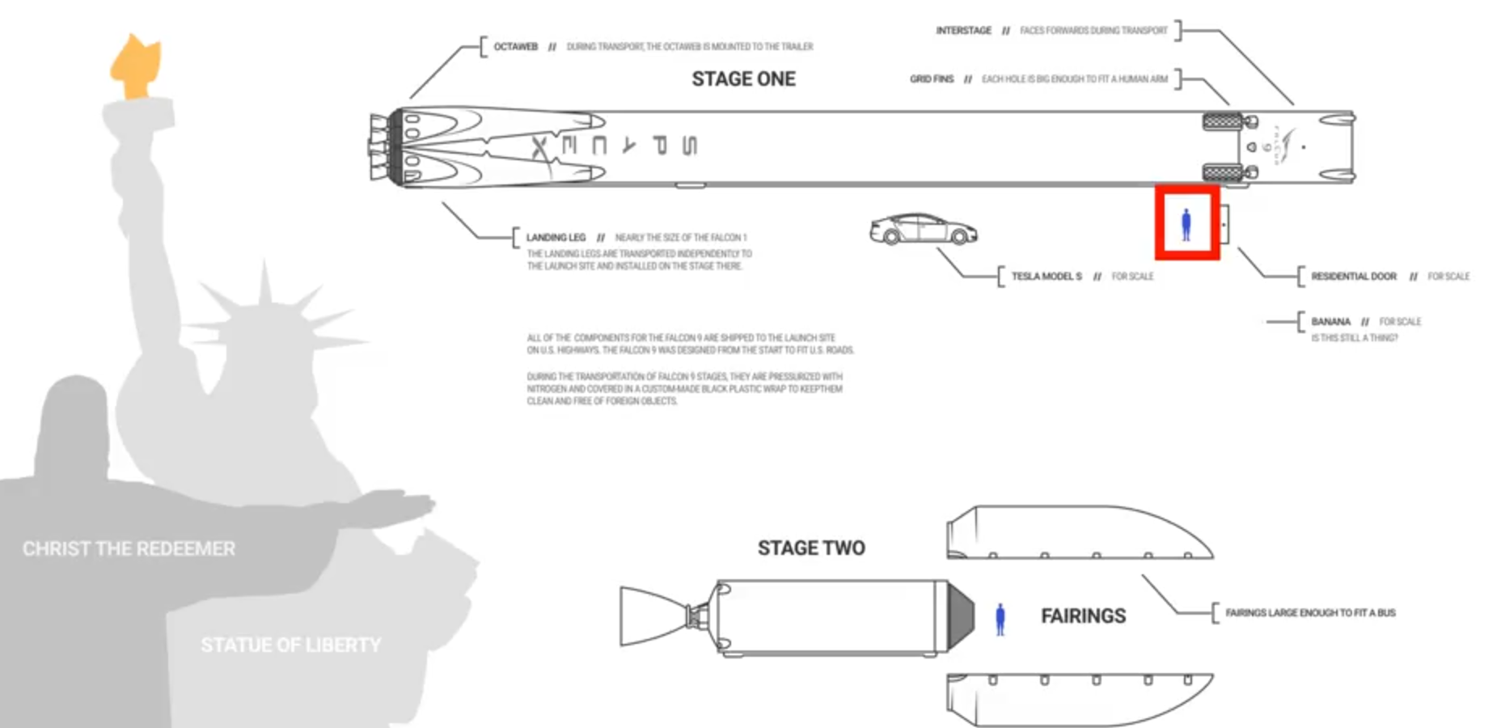
Introduction
Companies are looking to commercialize space by making space travel affordable
SpaceX is one of, possibly the most successful, space travel companies
SpaceX’s rocket launches are relatively inexpensive because they reuse Stage 1
Can we use a machine learning model to predict if SpaceX will reuse the first stage?

Slide 5

Section 1

Slide 6
Methodology
Executive Summary
Data collection methodology:
SpaceX Launch data from an API, specifically REST API
Web scraping related Wiki pages
Perform data wrangling
Wrangling data using API and Booster, Launchpad, payload and core functions
Data stored as lists to create a dataset
Data filtered/sampled to remove Falcon 1 launches
Replace NULL values with averages
Perform exploratory data analysis (EDA) using visualization and SQL
Perform interactive visual analytics using Folium and Plotly Dash
Perform predictive analysis using classification models
Preprocessing to standardize the data
Using Train_test_split to split the data into training and testing data
Using hyperparameter values to determine the model with the best accuracy: Logistics Regression, Support Vector Machines, Decision Tree Classifier and K-nearest neighbors
Output confusion matrix

Slide 7
Data Collection
Data collection done with helper functions BoosterVersion, LaunchSite, PayloadData and Core
Requested rocket launch data from SpaceX API
Used json_normalize to convert to a dataframe
Extracted subset of the dataframe
Removed multiples
Converted date
Restricted dataframe to date

Slide 8
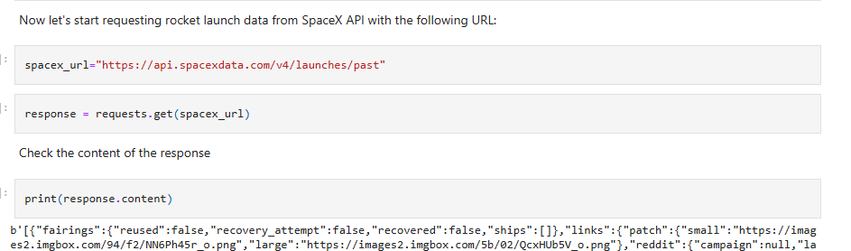
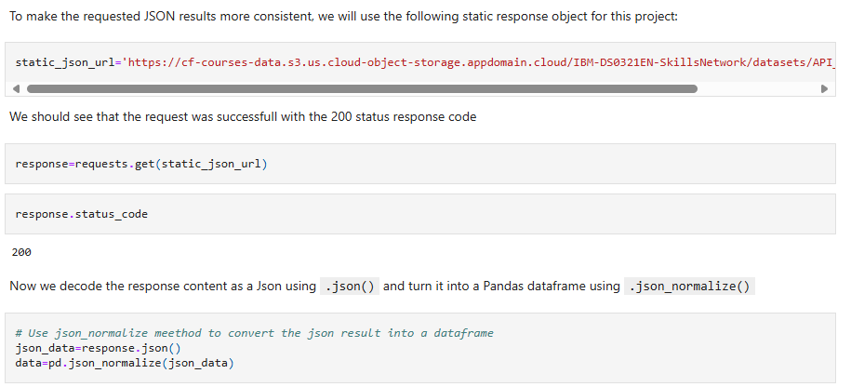
Data Collection – SpaceX API
Requested SpaceX API, requested JSON and normalized the content to create a dataframe
GitHub URL: Data-Science-Cert/jupyter-labs-spacex-data-collection-api.ipynb at Capstone · jswansin/Data-Science-Cert

Slide 9
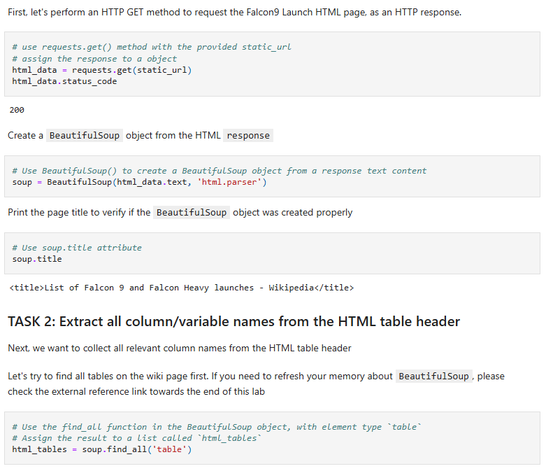
Data Collection - Scraping
Applied web scrapping for Falcon 9 launch records and parsed the table before converting it to a dataframe
GitHub URL: Data-Science-Cert/jupyter-labs-webscraping.ipynb at Capstone · jswansin/Data-Science-Cert

Slide 10
Data Wrangling
Calculated number of launches at each site
Calculated the number, occurrence and outcome of each orbit
Created a label for landing outcome
GitHub UR: Data-Science-Cert/labs-jupyter-spacex-Data wrangling.ipynb at Capstone · jswansin/Data-Science-Cert

Slide 11
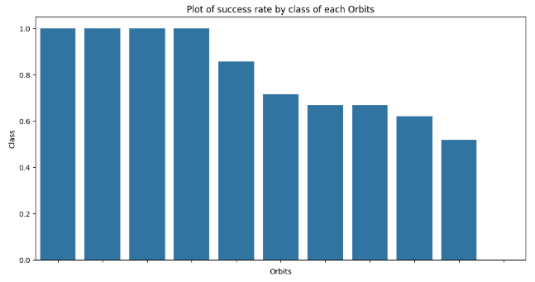
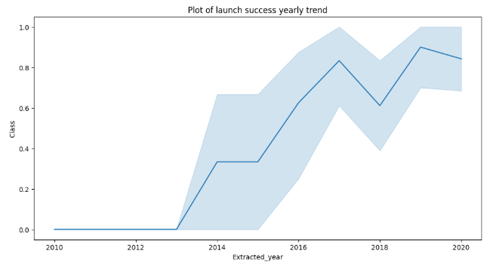
EDA with Data Visualization
Relationship between success rate of each orbit – valuable to end prediction goals
Plot of launch success yearly trend – again, valuable to end prediction goals
GitHub UR: Data-Science-Cert/jupyter-labs-visualization.ipynb at Capstone · jswansin/Data-Science-Cert

Slide 12
EDA with SQL
The following data insights were retrieved:
Displayed names of launch sites
Displayed 5 records with CCA launch sites
Displayed total payload mass for NSA (CRS) launches
Displayed average payload mass for F9 v1.1 boosters
Determined date of first successful landing on ground pad
Listed the names of successful boosters between 4000 and 6000 payload mass
Total number of successful and failed missions
Listed the names of boosters with maximum payload
Listed failed landings by booster version for 2015
Ranked the count of landing outcomes between given date range
GitHub URL: Data-Science-Cert/jupyter-labs-eda-sql-coursera_sqllite.ipynb at Capstone · jswansin/Data-Science-Cert

Slide 13
Build an Interactive Map with Folium
Marked all launch sites on map
Marked the success/failed launches for each site
Calculated the distances between a launch site to its proximities (such as railways, highways or coastlines)
GitHub UR: Data-Science-Cert/lab_jupyter_launch_site_location.ipynb at Capstone · jswansin/Data-Science-Cert

Slide 14
Build a Dashboard with Plotly Dash
Interactive dashboard was built with Plotly dash including:
Pie charts showing the total launches by site
Scatter graphs showing relationship between Outcome and Payload Mass for selected booster
GitHub URL:Data-Science-Cert/spacex_dash_app.py at Capstone · jswansin/Data-Science-Cert

Slide 15
Predictive Analysis (Classification)
After creating a columns for class, the data was standardized
Data was split into training data and test data
Determined best hyperparameter for SVM, classification trees and logistic regression
Found the best method based on accuracy
GitHub URL: Data-Science-Cert/SpaceX_Machine Learning Prediction_Part_5.ipynb at Capstone · jswansin/Data-Science-Cert

Slide 16
Results
Exploratory data analysis results
Interactive analytics demo in screenshots
Predictive analysis results

Slide 17

Section 2

Slide 18
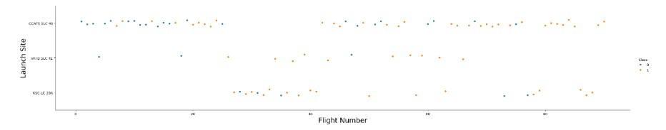
Flight Number vs. Launch Site
The more flights launched at the site is proportional to the success rate at the site.

Slide 19
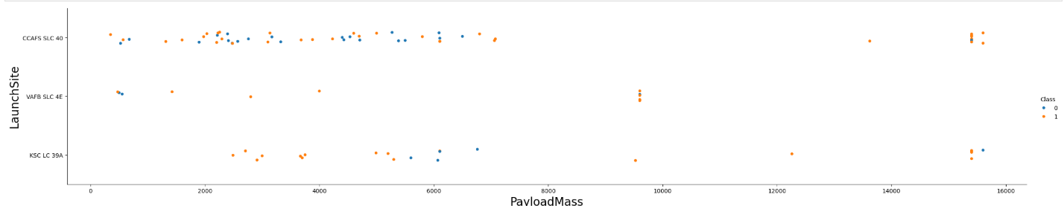
Payload vs. Launch Site
The higher the payload mass at CCAFS SLC 40, the higher the success rate.

Slide 20

Success Rate vs. Orbit Type
Certain orbits had a higher success rate.

Slide 21
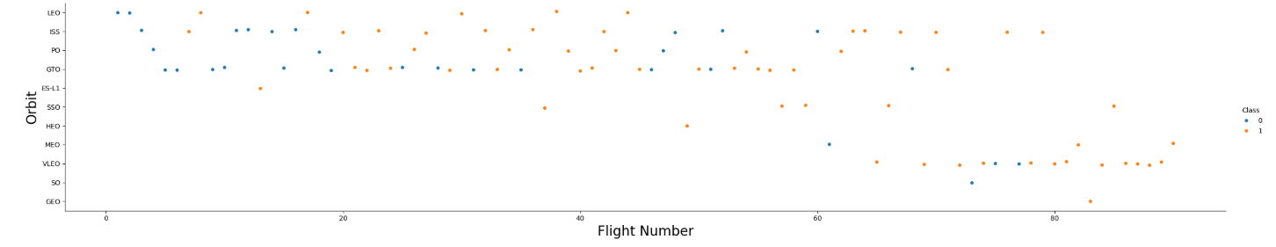
Flight Number vs. Orbit Type
In higher orbit, increasing the number of flights increases the success rate. This is not necessarily true at lower orbit.

Slide 22
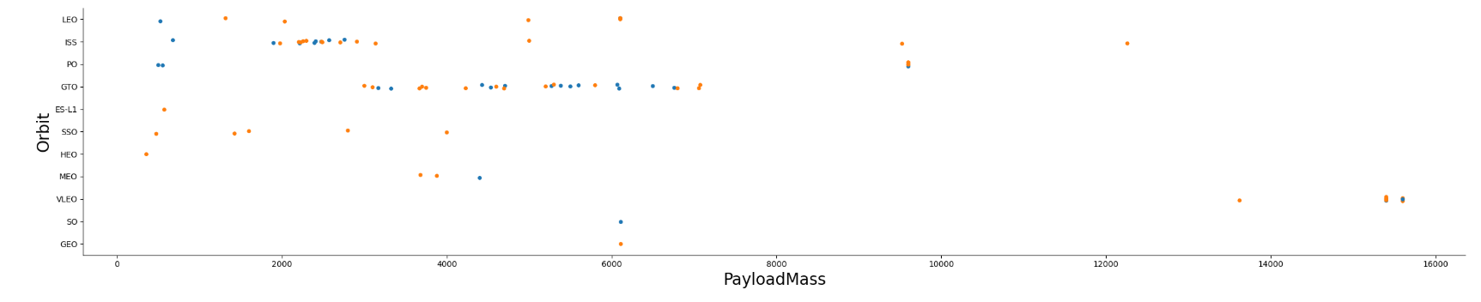
Payload vs. Orbit Type
There is a higher success rate for higher payloads in PO, LEO and ISS orbits.

Slide 23
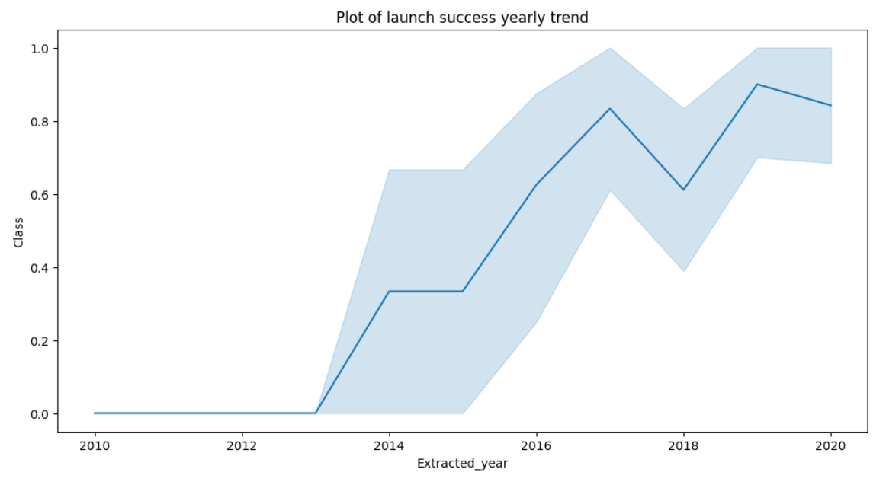
Launch Success Yearly Trend
In general, success rate increases each year.
However, there were declines in 2018 and 2020.

Slide 24
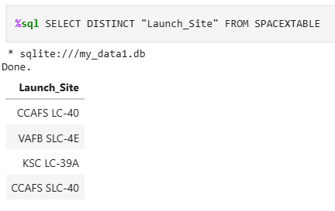
All Launch Site Names
DISTINCT command used in sql used to extract unique launch sites.

Slide 25
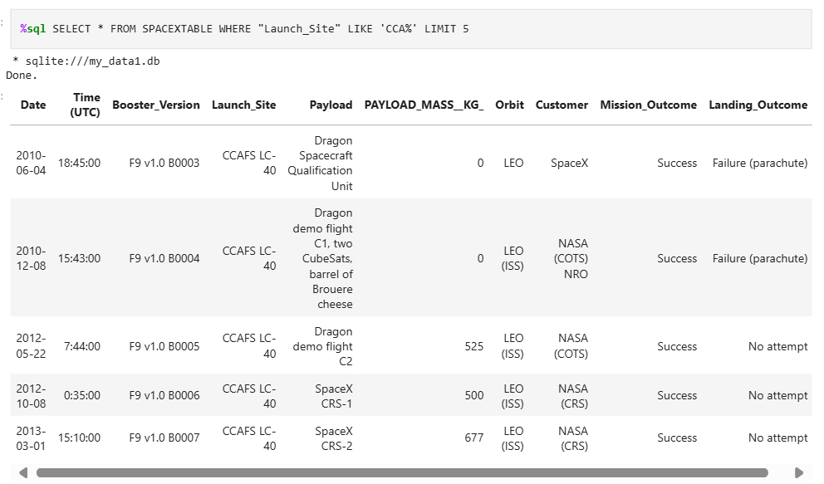
Launch Site Names Begin with 'CCA'
WHERE, LIKE and LIMIT used to extract 5 lines starting with CCA as Launch Site.

Slide 26
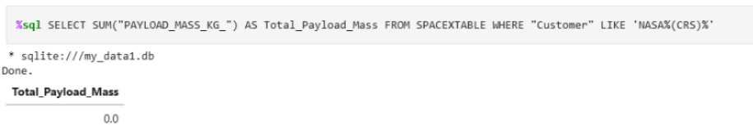
Total Payload Mass
Current approach inaccurate as reported total was zero.

Slide 27
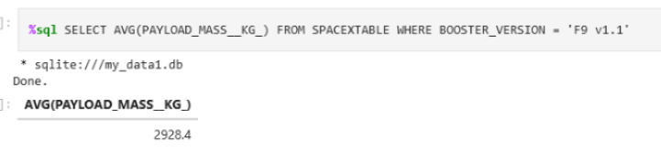
Average Payload Mass by F9 v1.1
Calculated the average payload mass carried by booster version F9 v1.1 to be 2928 kg using AVG, FROM and WHERE.

Slide 28
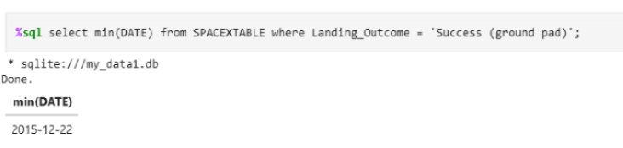
First Successful Ground Landing Date
First successful landing outcome on ground pad WAS 12/22/2015. Result was found using mid(DATE) and WHERE.

Slide 29
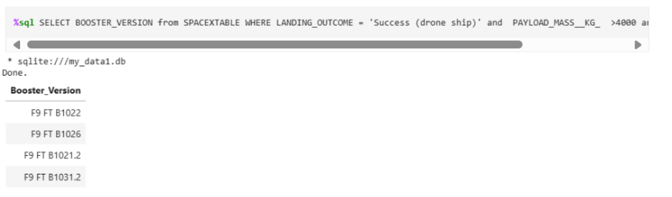
Successful Drone Ship Landing with Payload between 4000 and 6000
WHERE and AND commands used with ‘Success (drone ship)’ and Payload mass constraints.

Slide 30
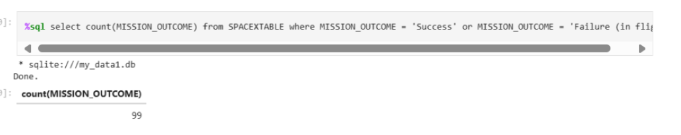
Total Number of Successful and Failure Mission Outcomes
COUNT, WHERE and OR used to calculate number of mission outcomes.

Slide 31
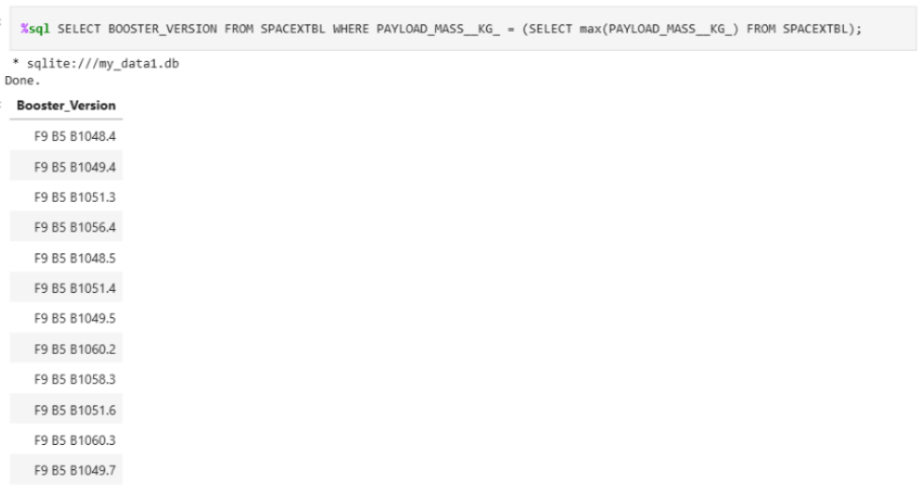
Boosters Carried Maximum Payload
WHERE and MAX used to extract booster names that carried the maximum payload.

Slide 32
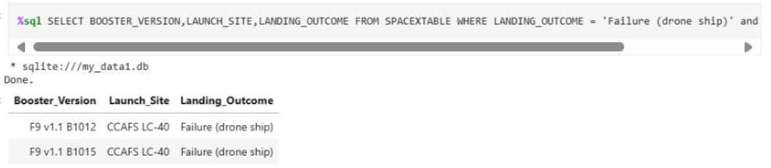
2015 Launch Records
WHERE and AND used to extract multiple columns.

Slide 33
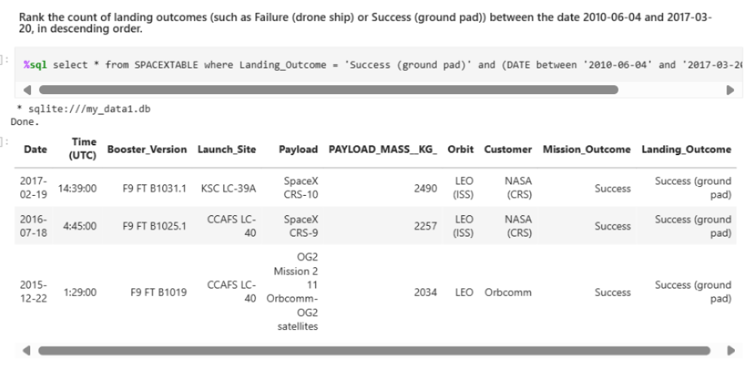
Rank Landing Outcomes Between 2010-06-04 and 2017-03-20
WHERE, AND, and ORDER used to present results.

Slide 34

Section 3

Slide 35
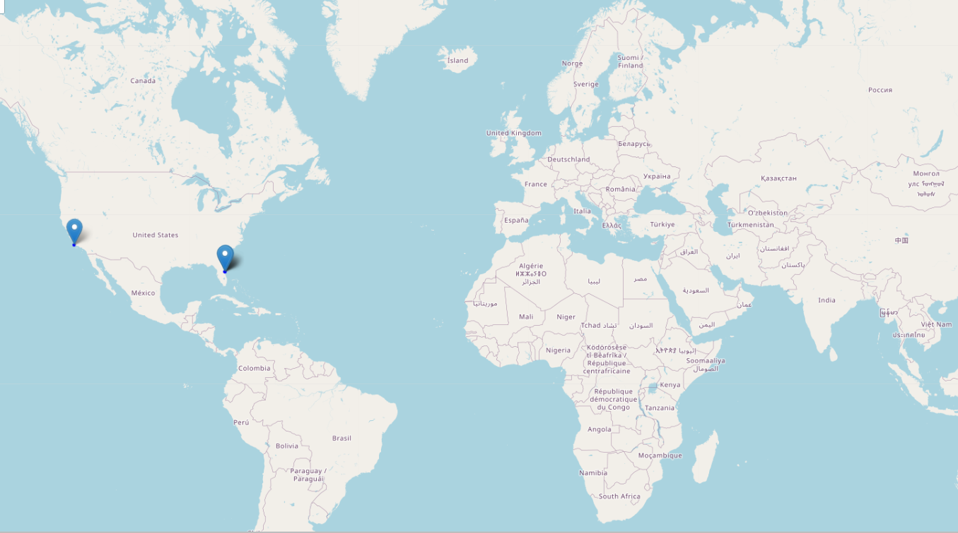
Launch Site Locations on Global Map
Launch locations are Florida and California in the USA.

Slide 36
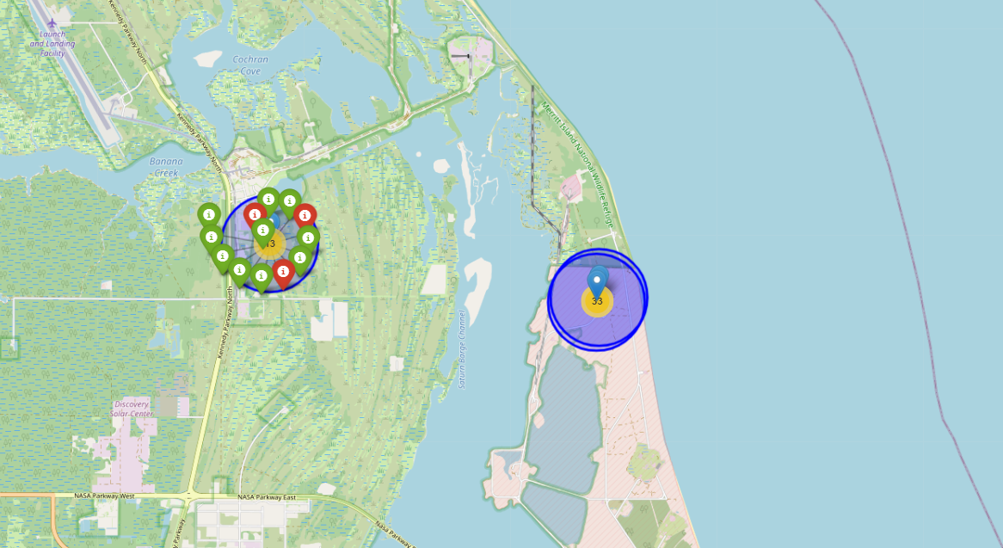
Colo-Labeled Launch Outcomes
Map indicates number of successful (green) launches and failed (red) launches.

Slide 37
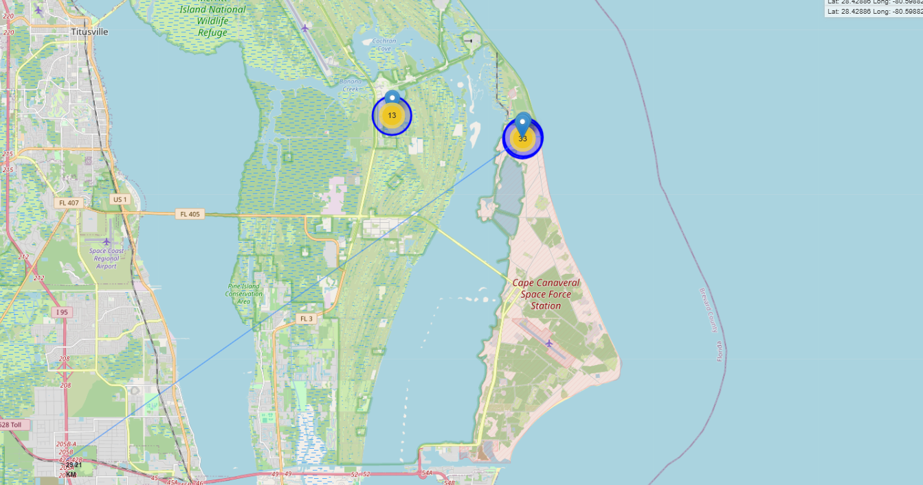
Launch Site Proximities
Map shows selected launch site to its proximities such as railway, highway, coastline, with distance calculated and displayed.

Slide 38

Section 4

Slide 39
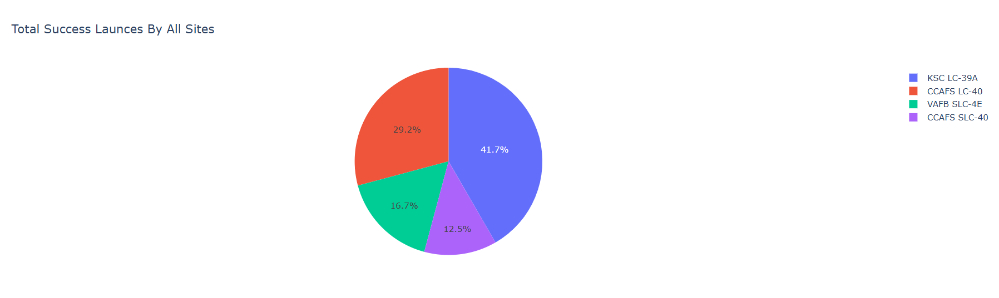
Launch Success for All Sites
KSC LC-39A had most successful launches.

Slide 40
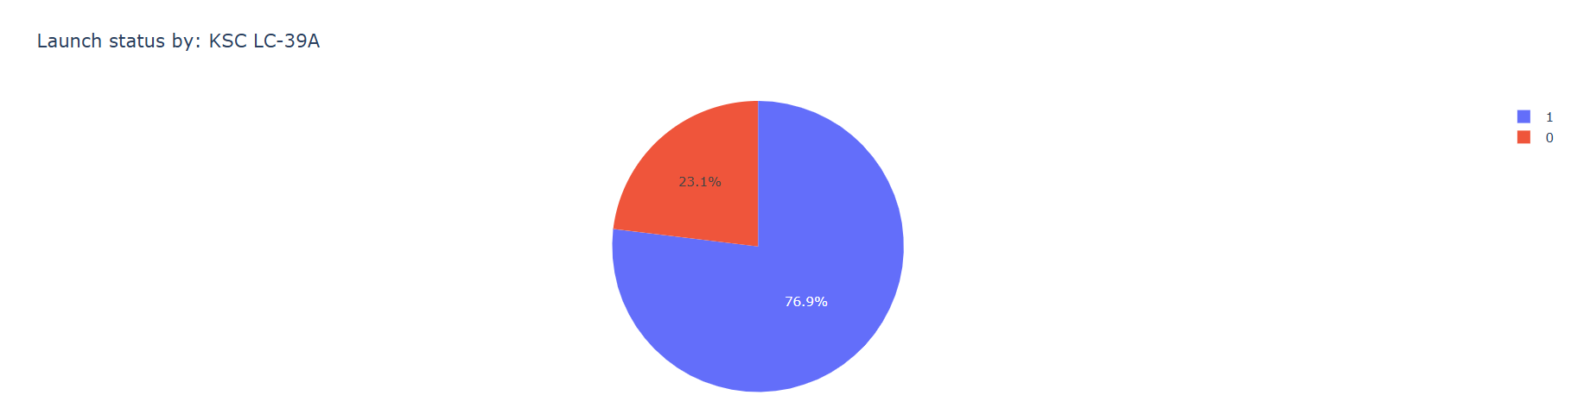
Launch Success for KSC LC-39A
Launch site KSC LC-39A had a 76.9% success rate.

Slide 41
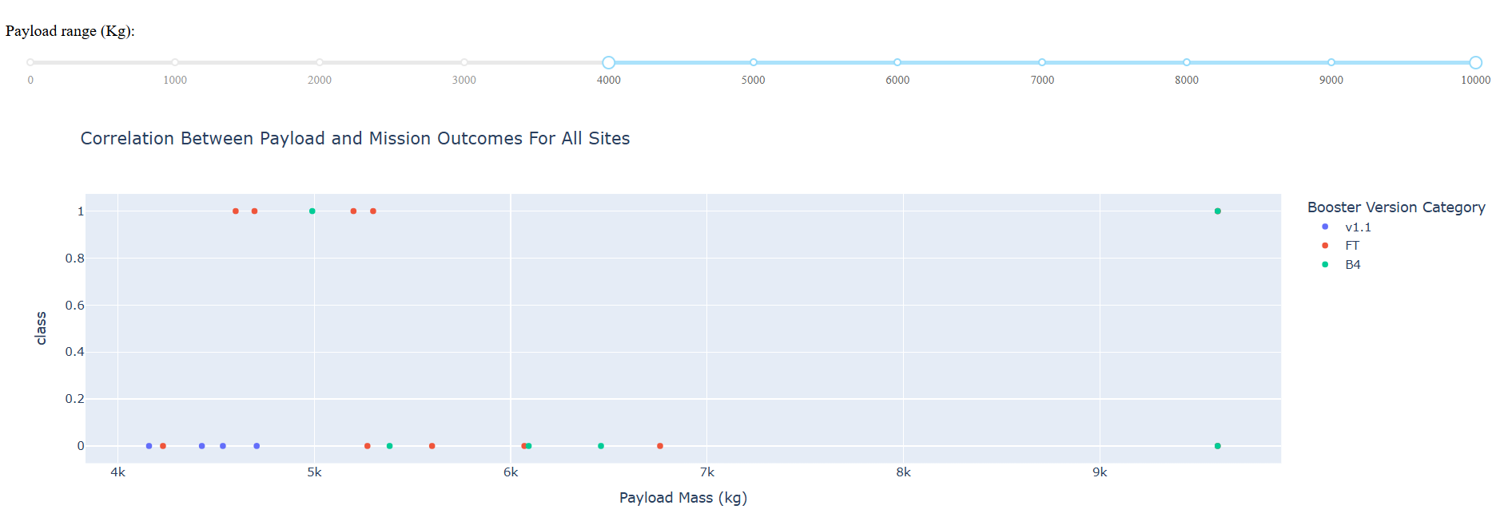
Payload v Launch Outcome (All Sites)
Scatter plot for all sites, with different payload selected in the range slider. 4000 kg an above selected for image below.

Slide 42

Section 5

Slide 43
Classification Accuracy
Decision tree model shows highest accuracy when compared to other models.

Slide 44
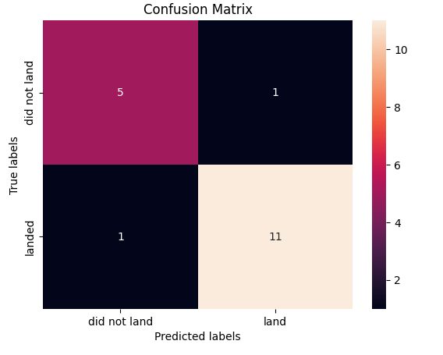
Confusion Matrix
Confusion tree matrix for decision tree model. It correctly predicted a landing when it landed 11 times and a failure when it did not land 5 times.
This is higher than any of the other 3 models.

Slide 45
Conclusions
More flights launched at the site is proportional to the success rate at the site.
In general, success rate increases each year.
KSC LC-39A launch site had most successful launches.
Decision tree classifier is the most accurate model for this study.

Slide 46


